Slide 1
Business Statistics:
A First Course
(3rd Edition)
Chapter 2
Presenting Data in Tables and Charts

Slide 2
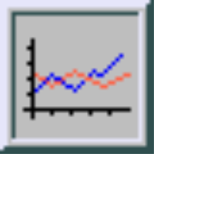
Chapter Topics
Organizing Numerical Data
  The Ordered Array and Stem-Leaf Display
Tabulating and Graphing Univariate Numerical Data
  Frequency Distributions: Tables, Histograms, Polygons
  Cumulative Distributions: Tables, the Ogive
Graphing Bivariate Numerical Data

Slide 3
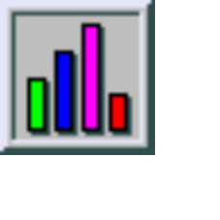
Chapter Topics
(continued)
Tabulating and Graphing Univariate Categorical Data
  The Summary Table
  Bar and Pie Charts, the Pareto Diagram
Tabulating and Graphing Bivariate Categorical Data
  Contingency Tables
  Side by Side Bar Charts
Graphical Excellence and Common Errors in Presenting Data

Slide 4

Organizing Numerical Data
Numerical Data
41, 24, 32, 26, 27, 27, 30, 24, 38, 21
Frequency Distributions
Cumulative Distributions
Ordered Array
21, 24, 24, 26, 27, 27, 30, 32, 38, 41
2 144677
3 028
4 1
Histograms
Ogive
Stem and Leaf
Display
Tables
Polygons

Slide 5

Organizing Numerical Data
(continued)
Data in Raw Form (as collected):
24, 26, 24, 21, 27, 27, 30, 41, 32, 38
Data in Ordered Array from Smallest to Largest:
21, 24, 24, 26, 27, 27, 30, 32, 38, 41
Stem-and-Leaf Display:
2 1 4 4 6 7 7
3 0 2 8
4 1

Slide 6
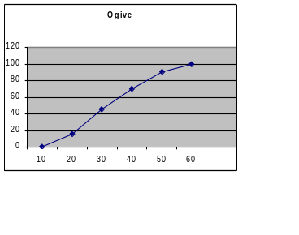
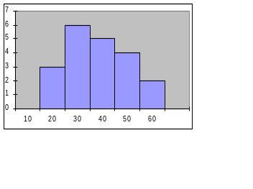

Tabulating and Graphing Numerical Data
Numerical Data
41, 24, 32, 26, 27, 27, 30, 24, 38, 21
Frequency Distributions
Cumulative Distributions
Ordered Array
21, 24, 24, 26, 27, 27, 30, 32, 38, 41
2 144677
3 028
4 1
Histograms
Ogive
Stem and Leaf
Display
Tables
Polygons

Slide 7
Tabulating Numerical Data: Frequency Distributions
Sort Raw Data in Ascending Order
12, 13, 17, 21, 24, 24, 26, 27, 27, 30, 32, 35, 37, 38, 41, 43, 44, 46, 53, 58
Find Range: 58 - 12 = 46
Select Number of Classes: 5 (usually between 5 and 15)
Compute Class Interval (width): 10 (46/5 then round up)
Determine Class Boundaries (limits): 10, 20, 30, 40, 50, 60
Compute Class Midpoints: 15, 25, 35, 45, 55
Count Observations & Assign to Classes

Slide 8
Frequency Distributions, Relative Frequency Distributions and Percentage Distributions
Data in ordered array:
12, 13, 17, 21, 24, 24, 26, 27, 27, 30, 32, 35, 37, 38, 41, 43, 44, 46, 53, 58
Relative
Frequency
Percentage
Class Frequency
10 but under 20 3 .15 15
20 but under 30 6 .30 30
30 but under 40 5 .25 25
40 but under 50 4 .20 20
50 but under 60 2 .10 10
Total 20 1 100

Slide 9
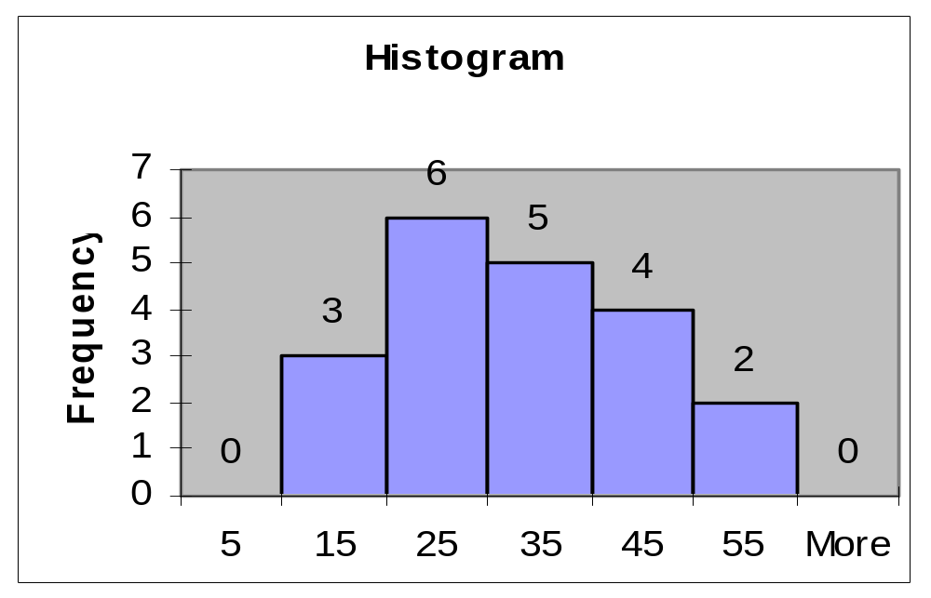
Graphing Numerical Data:
The Histogram
Data in ordered array:
12, 13, 17, 21, 24, 24, 26, 27, 27, 30, 32, 35, 37, 38, 41, 43, 44, 46, 53, 58
No Gaps Between Bars
Class Boundaries
Class Midpoints

Slide 10
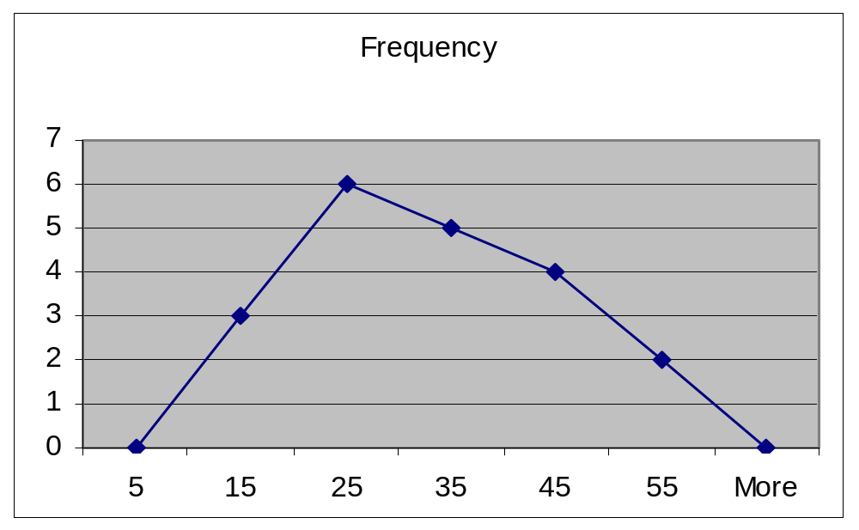
Graphing Numerical Data:
The Frequency Polygon
Data in ordered array:
12, 13, 17, 21, 24, 24, 26, 27, 27, 30, 32, 35, 37, 38, 41, 43, 44, 46, 53, 58
Class Midpoints

Slide 11
Tabulating Numerical Data:
Cumulative Frequency
Data in ordered array:
12, 13, 17, 21, 24, 24, 26, 27, 27, 30, 32, 35, 37, 38, 41, 43, 44, 46, 53, 58
Lower Cumulative Cumulative
Limit Frequency % Frequency
10 0 0
20 3 15
30 9 45
40 14 70
50 18 90
60 20 100

Slide 12
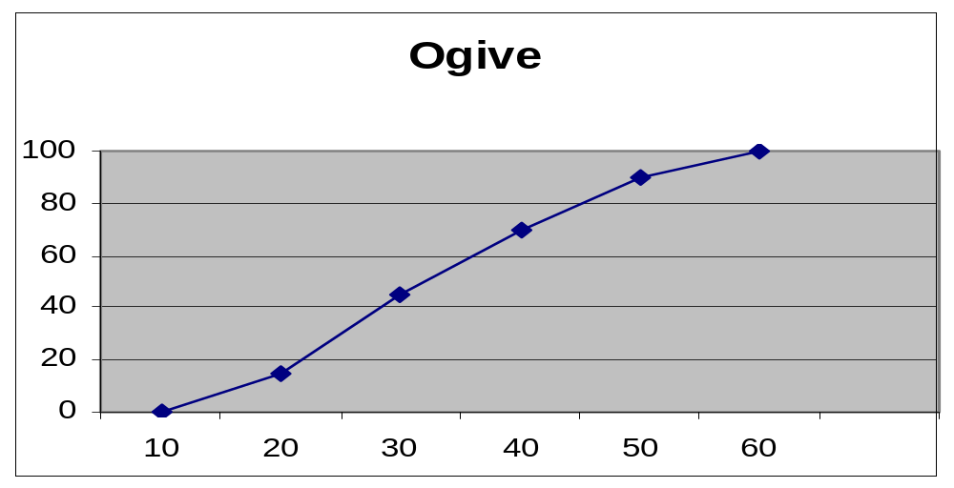
Graphing Numerical Data:
The Ogive (Cumulative % Polygon)
Data in ordered array:
12, 13, 17, 21, 24, 24, 26, 27, 27, 30, 32, 35, 37, 38, 41, 43, 44, 46, 53, 58
Class Boundaries (Not Midpoints)

Slide 13
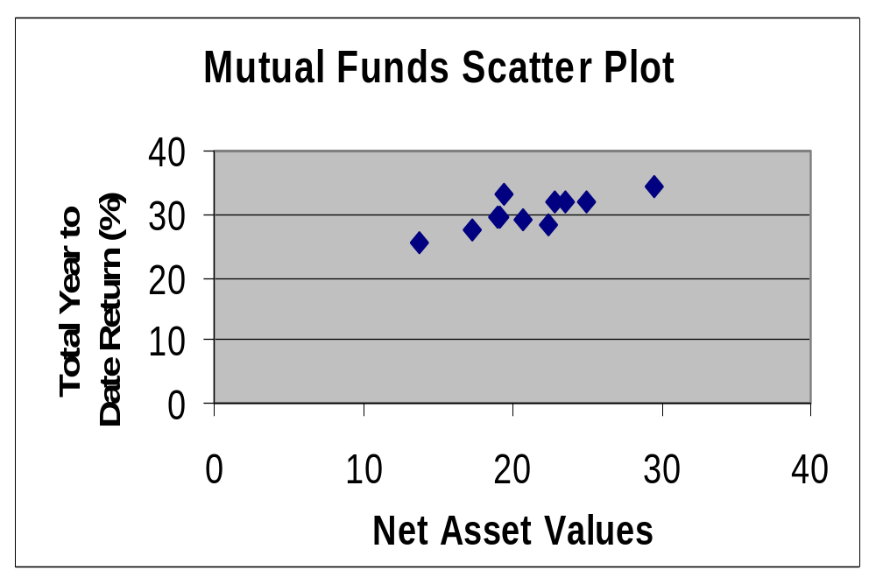
Graphing Bivariate Numerical Data (Scatter Plot)

Slide 14
Tabulating and Graphing Univariate Categorical Data
Categorical Data
Graphing Data
Tabulating Data
The Summary Table
Pie Charts
Bar Charts
Pareto Diagram

Slide 15
Summary Table
(for an Investor’s Portfolio)
Investment Category Amount Percentage
(in thousands $)
Stocks 46.5 42.27
Bonds 32 29.09
CD 15.5 14.09
Savings 16 14.55
Total 110 100
Variables are Categorical.

Slide 16
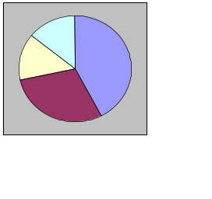
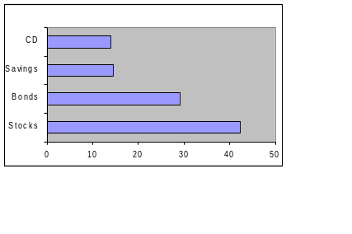
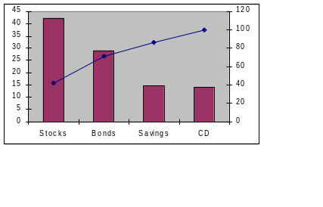
Graphing Univariate
Categorical Data
Categorical Data
Graphing Data
Tabulating Data
The Summary Table
Pie Charts
Bar Charts
Pareto Diagram

Slide 17
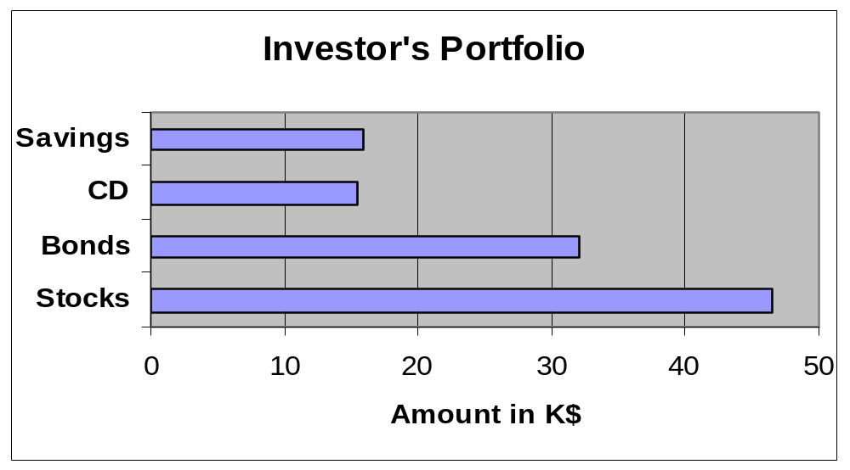
Bar Chart
(for an Investor’s Portfolio)

Slide 18
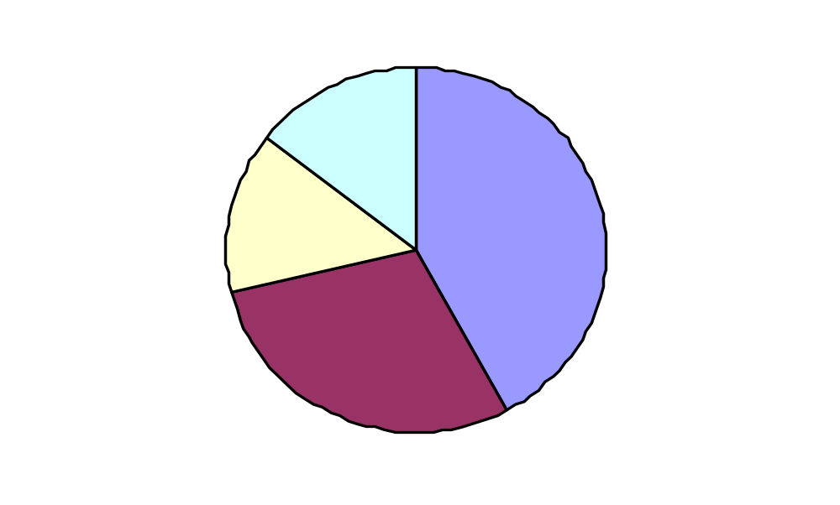
Pie Chart
(for an Investor’s Portfolio)
Amount Invested in K$
Savings
15%
Stocks
42%
CD 14%
Percentages are rounded to the nearest percent.
Bonds 29%

Slide 19
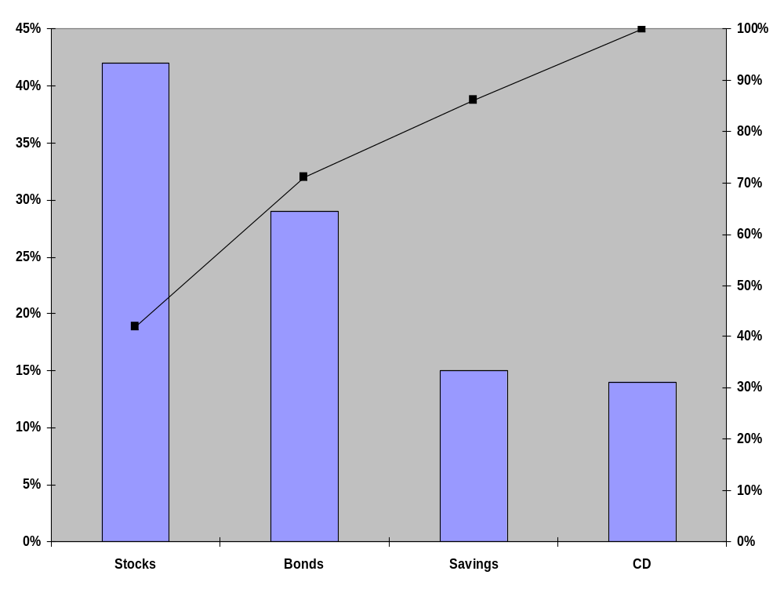
Pareto Diagram
Axis for bar chart shows % invested in each category
Axis for line graph shows cumulative % invested

Slide 20
Tabulating and Graphing Bivariate Categorical Data
Contingency Tables: Investment in Thousands of Dollars
Investment Investor A Investor B Investor C Total Category
Stocks 46.5 55 27.5 129
Bonds 32 44 19 95
CD 15.5 20 13.5 49
Savings 16 28 7 51
Total 110 147 67 324

Slide 21
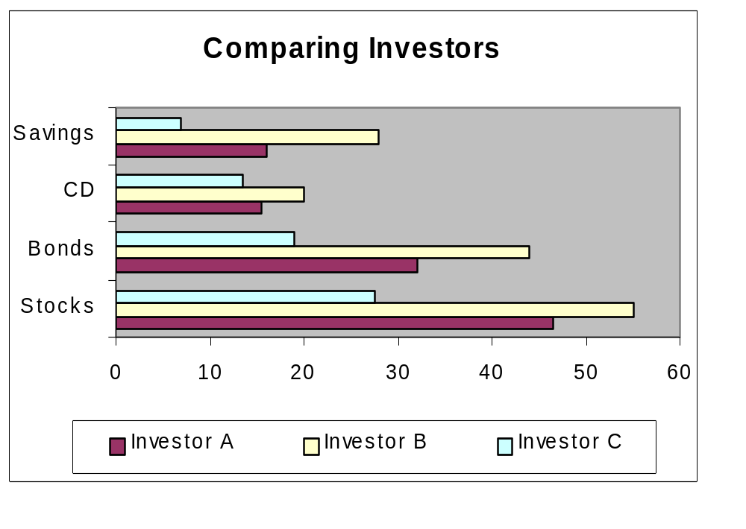
Tabulating and Graphing Bivariate Categorical Data
Side by Side Charts

Slide 22
Principles of Graphical Excellence
Well-Designed Presentation of Data that Provides:
  Substance
  Statistics
  Design
Communicate Complex Ideas with Clarity, Precision and Efficiency
Gives the Largest Number of Ideas in the Most Efficient Manner
Almost Always Involves Several Dimensions
Telling the Truth about the Data

Slide 23
Errors in Presenting Data
Using ‘Chart Junk’
No Relative Basis in Comparing Data between Groups
Compressing the Vertical Axis
No Zero Point on the Vertical Axis

Slide 24
‘Chart Junk’
✓
Bad Presentation
Good Presentation
Minimum Wage
Minimum Wage
$
1960: $1.00
4
1970: $1.60
2
1980: $3.10
0
1990: $3.80
1960
1970
1980
1990

Slide 25
No Relative Basis
Bad Presentation
✓
Good Presentation
A’s received by students.
A’s received by students.
Freq.
30
%
300
200
20
100
10
0
0
FR
SO
JR
SR
FR
SO
JR
SR
FR = Freshmen, SO = Sophomore, JR = Junior, SR = Senior

Slide 26
Compressing Vertical Axis
✓
Bad Presentation
Good Presentation
Quarterly Sales
Quarterly Sales
$
$
200
50
100
25
0
0
Q1
Q2
Q3
Q4
Q1
Q2
Q3
Q4

Slide 27
No Zero Point on Vertical Axis
Bad Presentation
✓
Good Presentation
Monthly Sales
Monthly Sales
$
$
45
45
42
42
39
39
36
36
J
F
M
A
M
J
0
J
F
M
A
M
J
Graphing the first six months of sales.

Slide 28
Chapter Summary
Organized Numerical Data
  The Ordered Array and Stem-Leaf Display
Tabulated and Graphed Univariate Numerical Data
  Frequency Distributions: Tables, Histograms, Polygon
  Cumulative Distributions: Tables, the Ogive
Graphed Bivariate Numerical Data

Slide 29
Chapter Summary
(continued)
Tabulated and Graphed Univariate Categorical Data
  The Summary Table
  Bar and Pie Charts, the Pareto Diagram
Tabulated and Graphed Bivariate Categorical Data
  Contingency Tables
  Side by Side Charts
Discussed Graphical Excellence and Common Errors in Presenting Data

